Slide 1
IoT-Based Pulse Oximeter
N. Sri Abirami Biomedical Engineering
SNS College of Technology

Slide 2
Problem Statement
Continuous monitoring of blood oxygen levels (SpO2) is critical for patients suffering from respiratory or cardiac conditions. Traditional oximeters require manual supervision and do not store or transmit real-time data

Slide 3
Objective:
To design a smart IoT-based pulse oximeter system that can:
Measure SpO2 and pulse rate using a sensor
Display the values in real-time
Send data wirelessly to cloud or a monitoring station

Slide 4
Components Used:
MAX30100 Sensor – Measures SpO2 and pulse rate
Arduino UNO – Controls logic and processing
NodeMCU (ESP8266) – Sends data over WiFi
OLED Display (0.96") – Shows readings
Thingspeak or Blynk App – For cloud dashboard

Slide 5
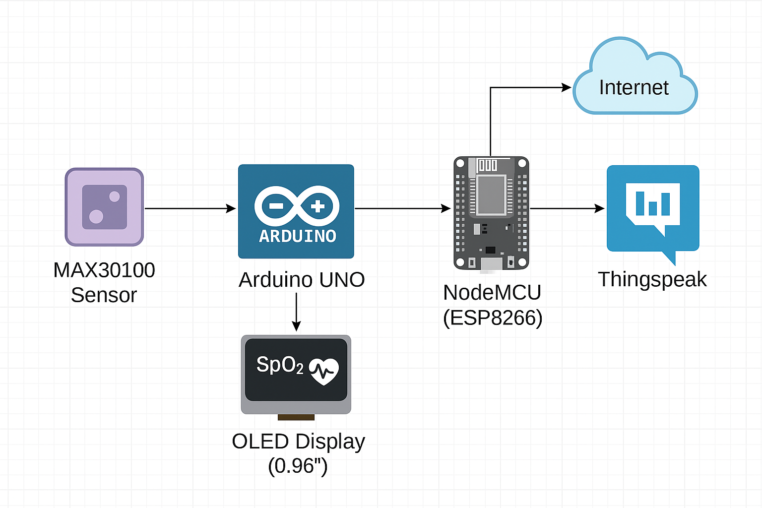
Working Block Diagram:

Slide 6
Benefits:
Real-time remote monitoring of patient oxygen levels
Reduces hospital visits for routine checks
Useful in telemedicine, ICUs, home care, and post-COVID monitoring
Data can be stored and analyzed over time

Slide 7
Conclusion & Future Scope:
This device bridges biomedical sensing and IoT technology to offer an accessible health monitoring tool.
Future Scope:
SMS/Call alerts to doctor on abnormal readings
Integration with mobile app or AWS IoT dashboard
Battery-powered wearable model

